Slide 1

Section 1 Project
Analysis of the King County housing market

Slide 2
Executive summary
The business case
What the model does and doesn’t do
The model in action
Possible next steps
Appendix contains additional analysis

Slide 3
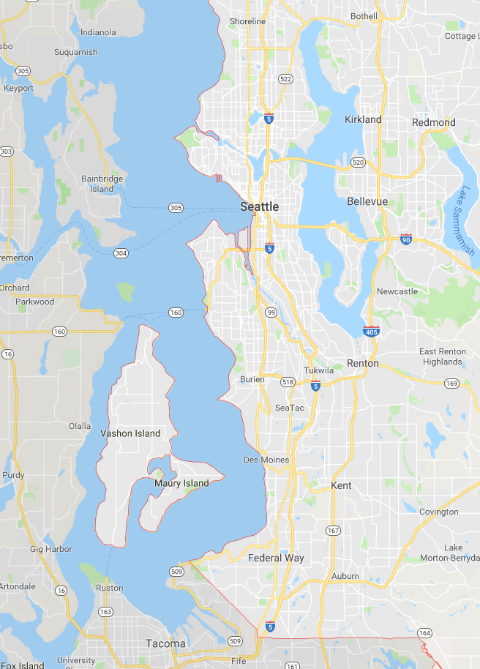
The business case
The King County housing market is worth over $11bn annually, with 60 properties being sold every day.
Being able to predict a property’s value based on its characteristics allows a real estate consultancy to:
Identify and invest in undervalued property
Evaluate the profitability of renovation work done to properties
Ensure that property is not sold below its intrinsic value

Slide 4
What the model does and doesn’t do
The presented model:
Predicts the sale price of a property, based on its characteristics
Considers properties in Western King County
Is appropriate for houses worth between $100k and $1m, and fewer than 6 bedrooms
Excludes any houses designated Grade 4 or below¹

Slide 5


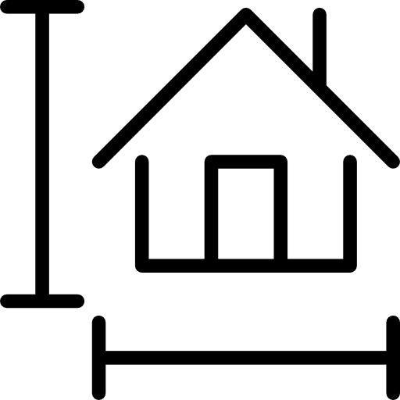






How the model works
Bedrooms
Grade¹
Size of lot²
Location³
1 Bedrooms: +$0.0
2 Bedrooms: +$58k
3 Bedrooms: +$92k
4 Bedrooms: +$116k
5 Bedrooms: +$135k
If property is of Grade:
5. -$275k
6. -$119k
7. +$12k
8. +$126k
1% increase in lot size results in $312 increase in property price.
If property in:
Area A. +$52k
Area B. +$66k
Area C. +$74k
Area D. -$125k
Area E. -$87k
Area F. -$160k
Area G. +$51k
Area H. -$117k
9. +$227k
10. +$317k
11. +$398k
12. +$473k
Example lot sizes:
10k ft². +$288k
20k ft² . +$3097k
30k ft² . +$322k
40k ft² . +$331k
50k ft² . +$338k
Build year
If property built between:
1899-1919. +$93k
1920-1939. +$80k
1940-1959. +$0k
1960-1979. -$49k
1980-1999. -$29k
Property condition⁴
Date of
transaction
Waterside
Basement
Condition 2. -$122k
Condition 3. -$56k
Condition 4. -$32k
Condition 5. +3k
If property sold in:
Q1. +$12.4k
Q2. +$11.8k
If property is waterside: +$271k
If property has a basement: +$29k

Slide 6
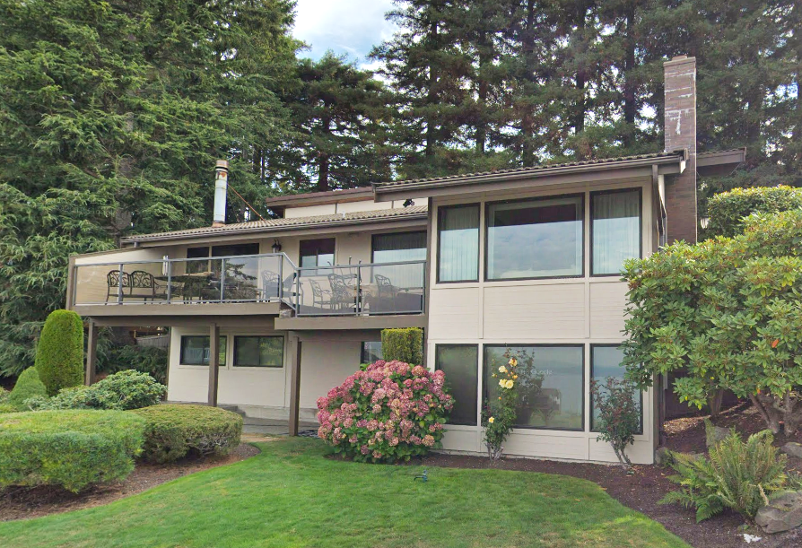
The model in action 1 – Normandy Park Waterfront
Current property value:
$787,644
The case: The homeowners want to build a basement to improve their property’s value, and need our consultancy’s advice!
One builder will construct a basement for $20k.
A second builder has offered to do the same basement, but also do renovation work that would improve the house’s condition to 4, all for $50k.
Which company should they go with?
Builder 1 house value = $816,897
... after builder fees = $796,897
Builder 2 house value = $841,663
... after builder fees = $791,663
✔︎
Bedrooms | 4
Grade | 8
Lot size | 21,500 ft²
Zipcode | 98166 (Area E)
Build year | 1979
Condition | 3
Sale date | April
Waterside | Yes
Basement | No

Slide 7
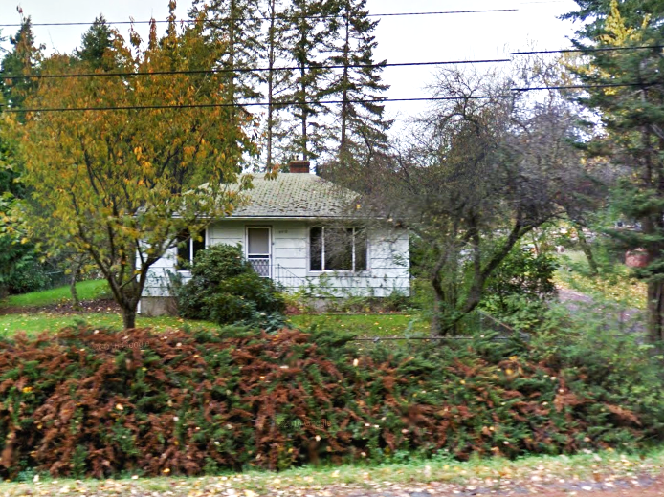
The model in action 2 – Vashon Island Cabin
Current property value:
$119,817
The case: Our company has the option to buy the property from its current owner for $130k.
We know that the neighbour would be willing to sell us 5,000ft² of adjacent land for $10k.
We estimate that doing the renovation work to bring the property to condition 3 would cost $20k.
House value with additional land = $131,346
Given the initial $130k purchase, the most we would pay for the extra land is $1,300
House value with condition 3 = $155,346
Given the initial $130k purchase, the most we would pay for the renovation is $15,300
Bedrooms | 1
Grade | 6
Lot size | 11,200 ft²
Location | 98070 (Area E)
Build year | 1983
Condition | 2
Sale date | February
Waterside | No
Basement | No

Slide 8
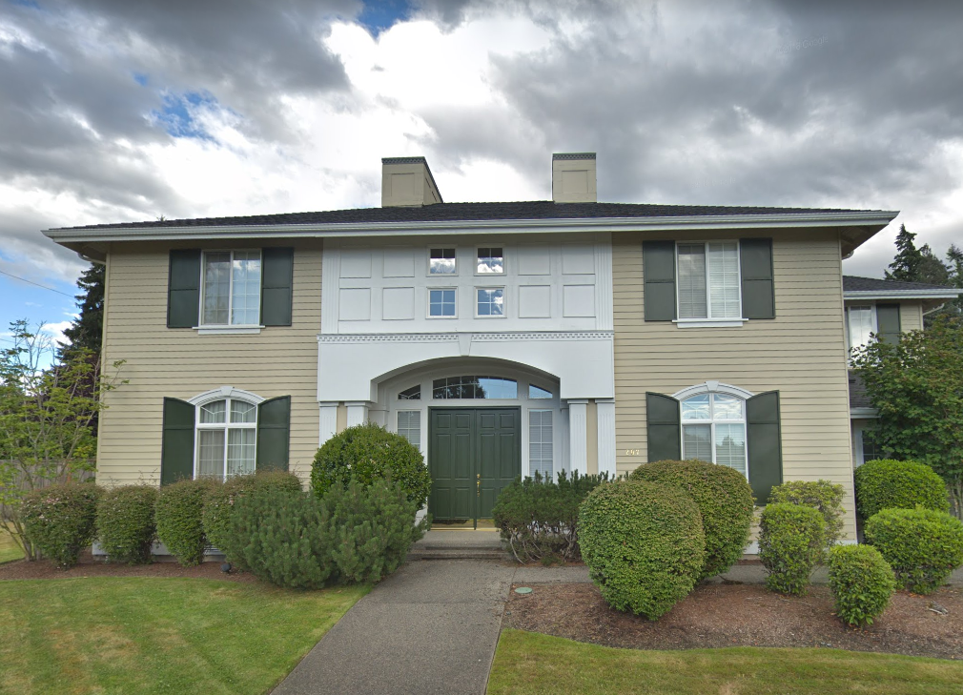
The model in action 3 – Belleview Family Home
Current property value:
$884,431
The case: The occupants are downsizing, and want to use the money to buy a 2 bedroom house in Duvall¹, and use any remaining money to buy a 2 bed house for their daughter in Seattle.
They won’t to downgrade on their current condition but can live with grade 8 and no basement. What kind of property could the daughter get?
Estimate Duvall house cost = $580k
Leaving $304k for daughter’s property
By using the model, we can calculate that $304k will buy a 2 bedroom, 80s/90s property in Seattle, though it will be grade 7, condition 4, and only be 2,400 ft²
Bedrooms | 5
Grade | 10
Lot size | 32,500 ft²
Zipcode | 98006 (Area C)
Build year | 1965
Condition | 5
Sale date | August
Waterside | No
Basement | Yes

Slide 9
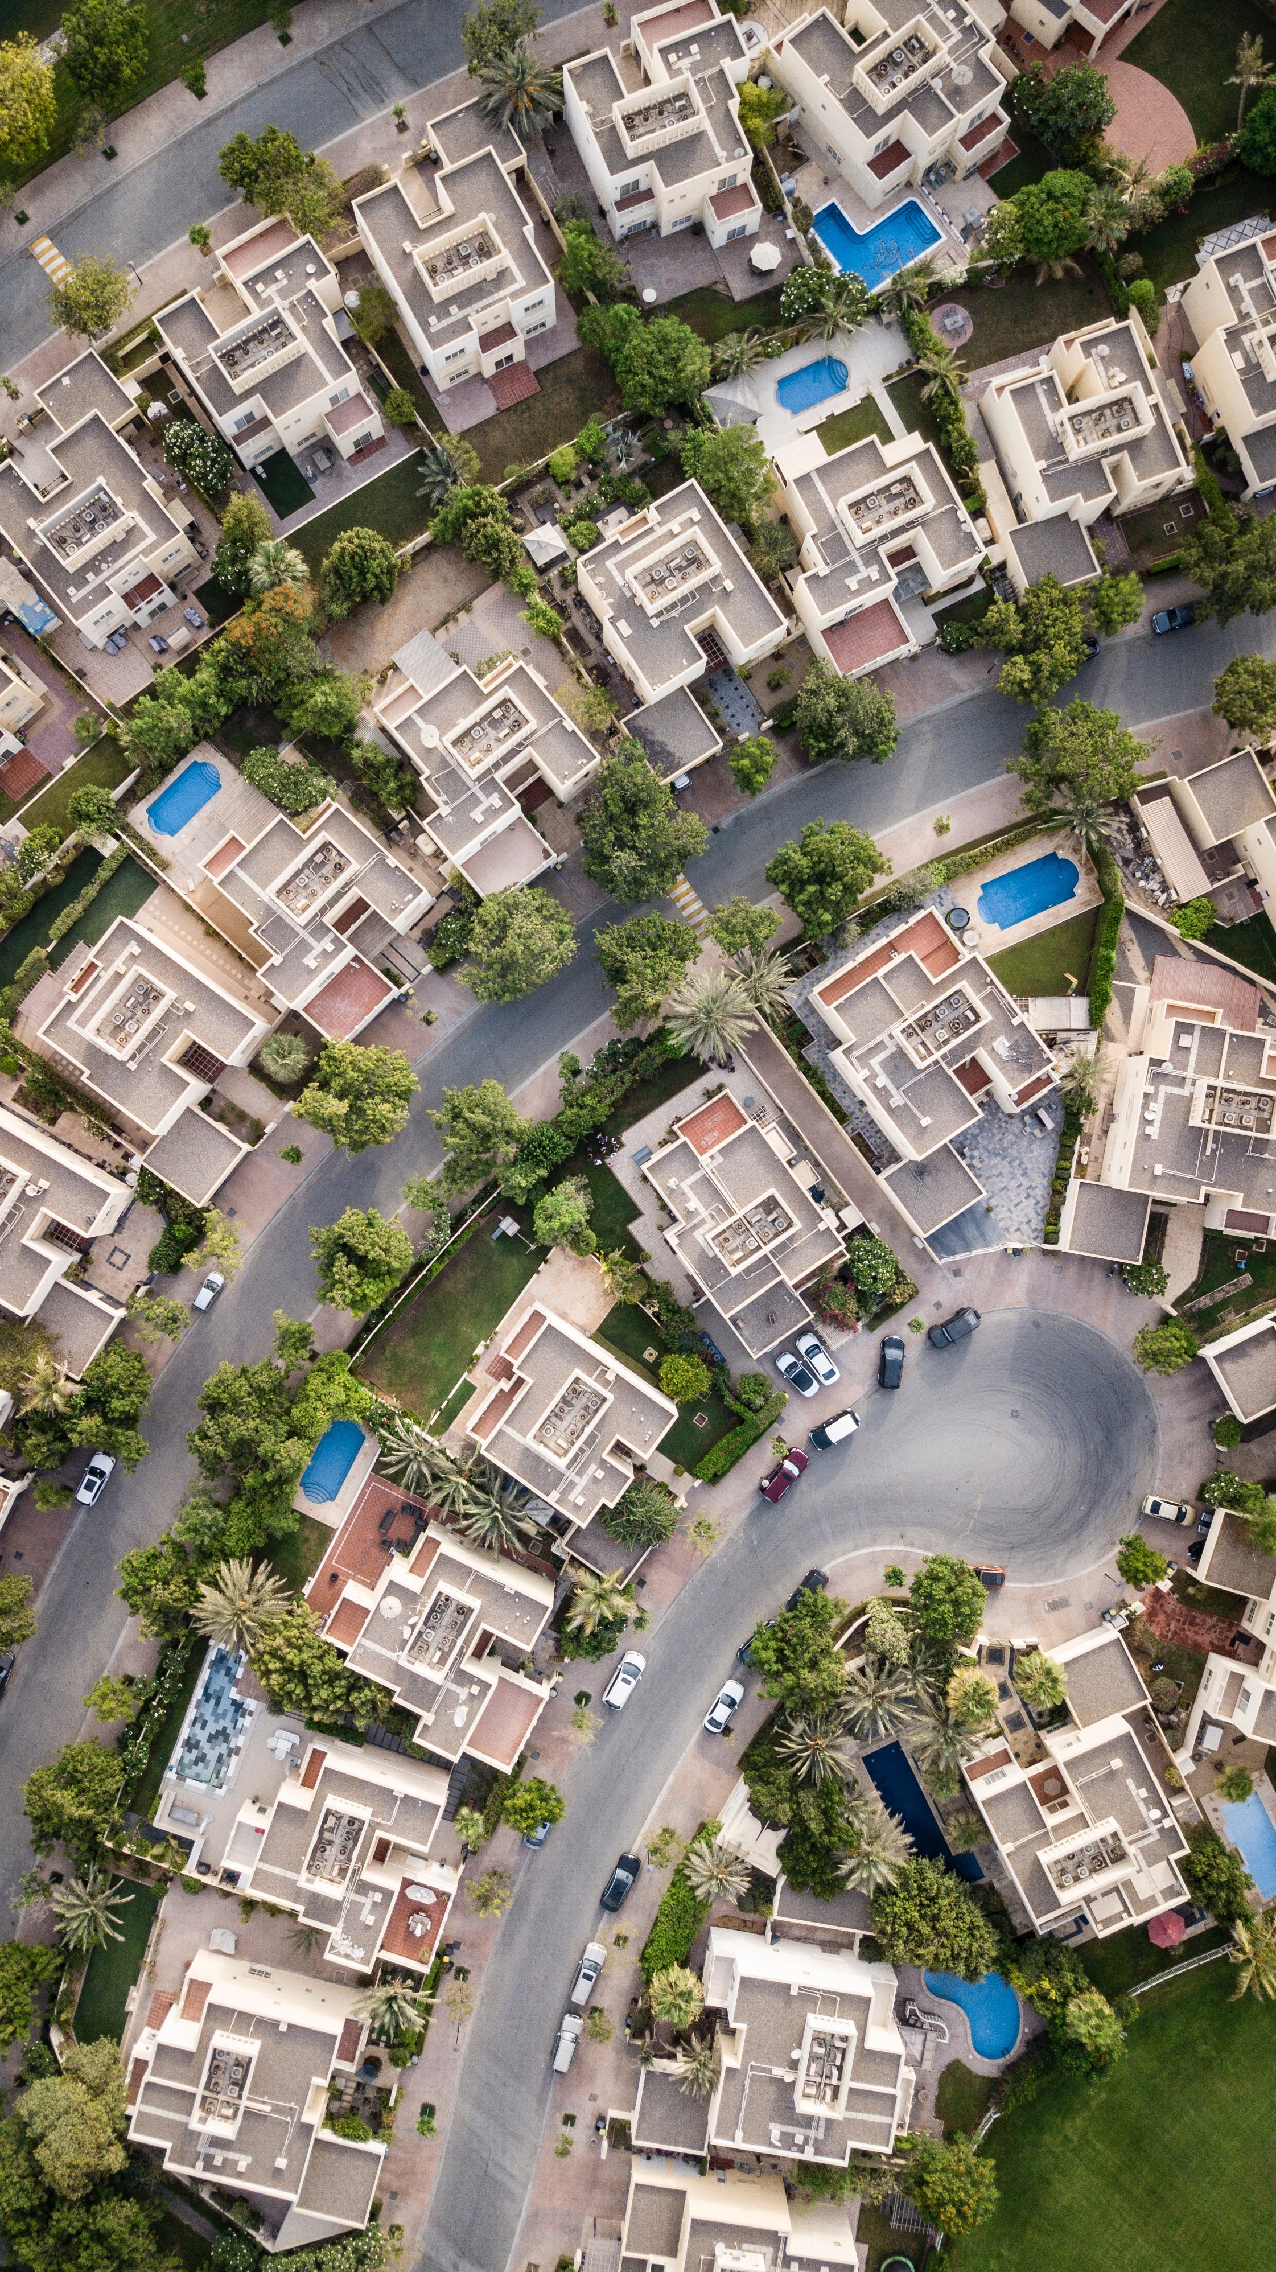
Possible next steps
To further improve the model, there are other things that could be investigated:
Create more versions of the dataset, using different decisions and assumptions during the initial data munging
Calculated more KPIs from existing dataset in order to identify more outliers
Use more granular zip code sorting
Go beyond linear regression, and investigate non-parametric models to improve predictive capabilities

Slide 10
Thank you for your time
Further detail on the model, and additional analysis of the dataset is included in further pages

Slide 11
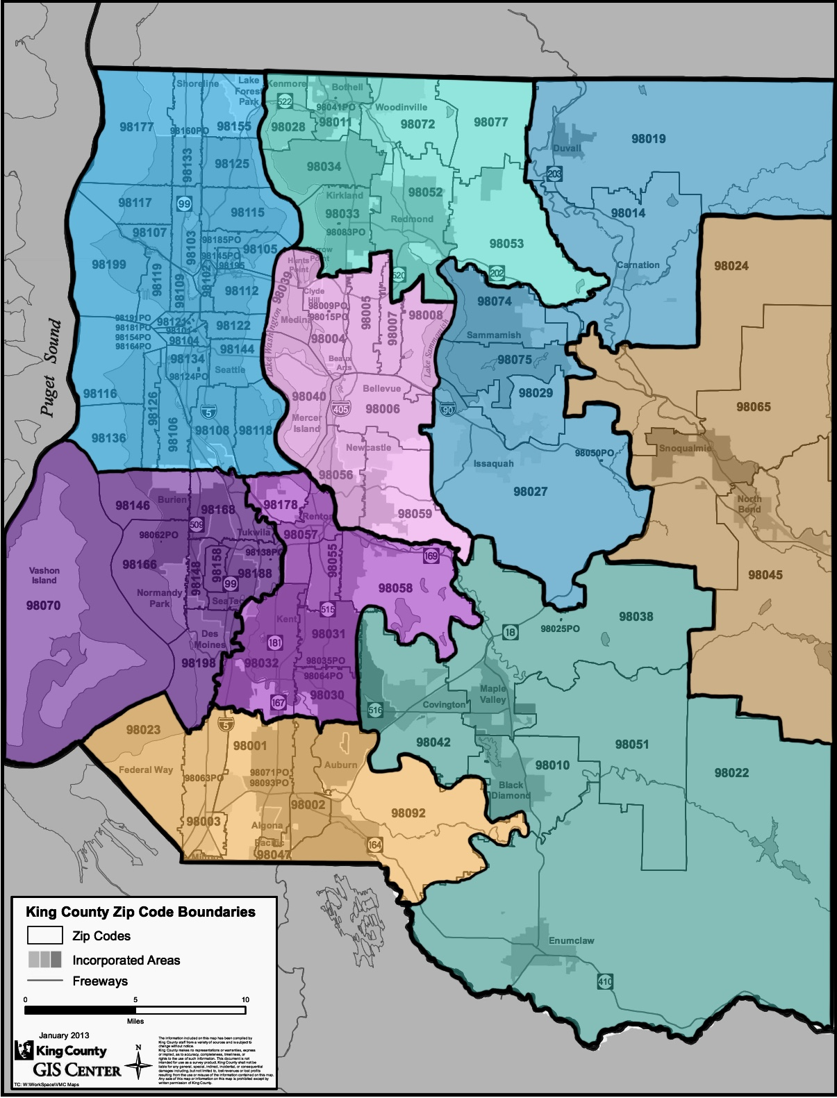
Map of King County, with areas demarcated
B
Seattle, Shoreline, Lake Forest Park
Kirkland, Kenmore, Bothell, Redmond, Woodinville
Bellevue, Mercer Island, Newcastle
Renton, Kent
Burien, Normandy Park, Des Moines, SeaTac, Tukwila, Vashon Island
Federal Way, Auburn, Algona, Milton, Pacific
Sammamish, Issaquah, Carnation, Duvall
Covington, Maple Valley, Black Diamond, Enumclaw
Snoqualmie, North Bend
A
G
C
I
E
D
F
H

Slide 12
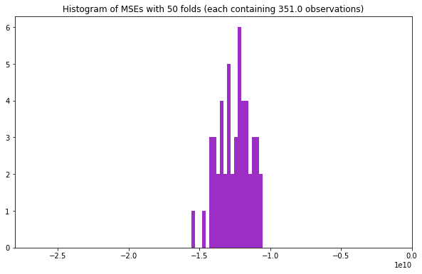
Full equation for model, and analysis of model fit
Estimated house price =
$83,766.8 * log (#bedrooms)
$85,4318.3 * log (grade)
$31,234.3 * log (lot size in ft²)
$270,635.4 if house is waterside
$29252.4 if house has basement
If condition 2: -$35,528.3, if condition 4: $24,766.1, if condition 5: $53,317.9,
If sale in Q1: +$12,423.4, if sale in Q2: +$11,812.4,
If house built in 1899-1920: +$93,013.9, 1920-1940: +$79,781.1, 1960-1980: -$48,900.0, $1980-2000: -$28,907.6,
If house in zip area A: +$51,516.3, zip area B: +$65,576.7, zip area C: +$74,431.3, zip area D: -$124,510.2, zip area E: -$87,154.4, zip area F: -$159,891.6, zip area G: +$50,994.7, zip area H: -$117,246.4
-$1,650,121 (constant term)
Model has: R² = 0.67, and adjusted R² = 0.67
The model thus explains over two thirds of the dataset’s variation from the mean price
The mean squared errors, using a 50-fold cross validation method, are within a relatively tight range (see histogram). This suggests that the model is not ’over-fitted’ to the data, and is could be used with new observations.

Slide 13
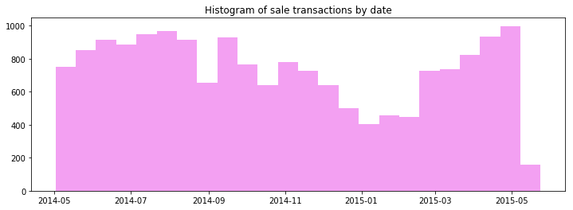
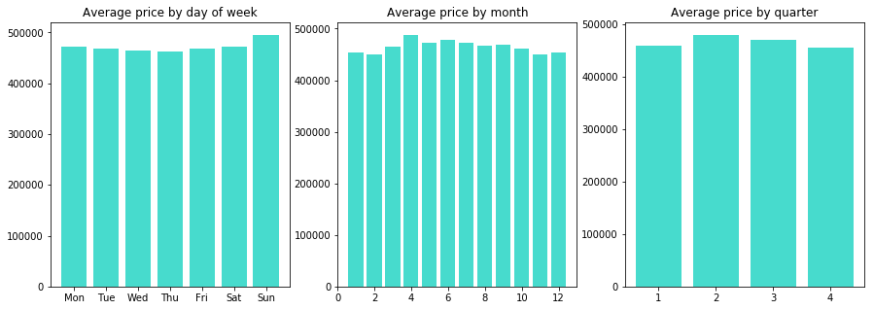
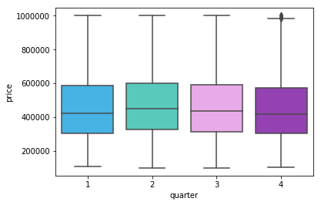
Additional analysis – seasonal effect on house sales
Number of sales does appear to be seasonal – the market slows down to half its peak in the first part of Q1, perhaps to be expected given the Christmas holidays. We would need further years of data to see if this trend persisted.
The average price fluctuates slightly by time of year as well. Q2 has the highest mean value sales, though the boxplot (bottom right) suggests that this is driven by a relative lack of cheaper houses.

Slide 14
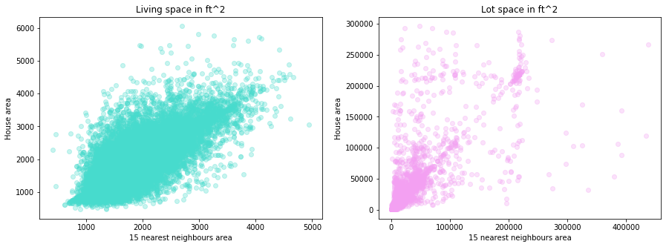
Additional analysis – 15 nearest neighbours
There is a relationship between the living space of a house and its 15 neighbouring properties. However, it is not a particularly strong correlation (R² is 0.54).
There is little correlation in lot space of neighbouring houses – suggesting that whilst houses close to each other are built to at least similar specifications, the plots of land are not necessarily apportioned equally between neighbours.

